Slide 1
Welcome!
As you come in…
Vocab quiz on desk complete with elbow partner and turn in
Second column of chart about Ash conformity (Article on Blog)
What was he trying to find out?
What’s the “storyline” of the experiment?
What were the results?

Slide 2
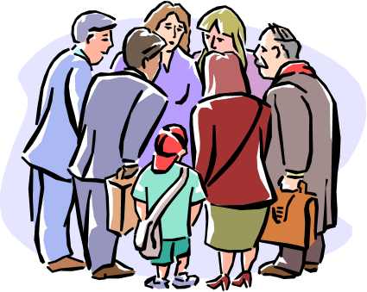
RG 14b

Slide 3
Listen Up!
Notes:
Quack like a duck

Slide 4
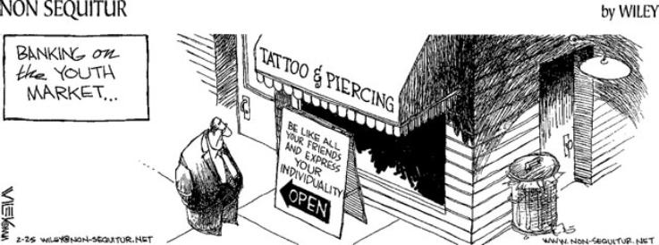
Social Influence
The greatest contribution of social psychology is its study of attitudes, beliefs, decisions, and actions and the way they are molded by the actions of others.

Slide 5
Social Roles
socially defined patterns of behavior that are expected of persons in a given setting or group
the roles you assume may result from your interests, abilities and goals OR they may be imposed on you by the group or by cultural, economic or biological conditions beyond your control
in any case…social roles prescribe your behavior by making obvious what you should do, how you should do it and when

Slide 6
Social Norms
a group’s expectations regarding what is appropriate and acceptable for its members’ attitudes and behaviors
can be broad guidelines (like political or religious views and policies) or quite specific (like being quiet in a library)
can guide conversation (what is acceptable to discuss), define dress code (in most offices you must wear “business attire” not t-shirts and shorts), or can be unwritten rules built into various situations (such as when a teacher is lecturing, students are to listen and not talk simultaneously)

Slide 7
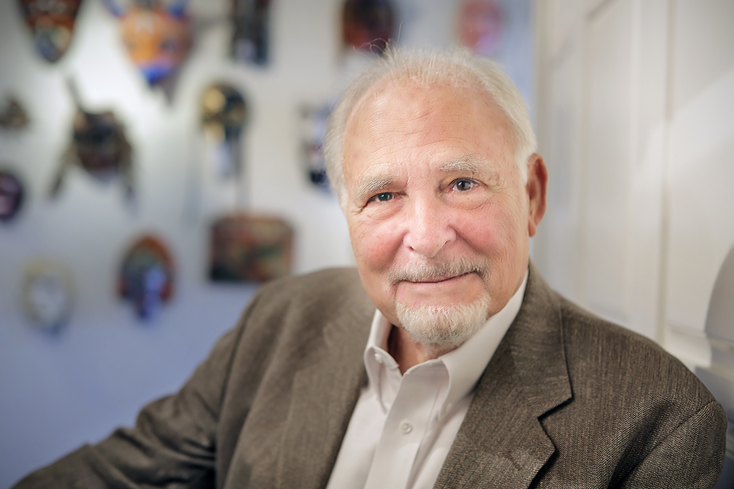
Display Rules – Not in the book but was on the 2019 exam FRQ
A socially learned standard that regulates the expression of emotion. Display rules vary by culture; for example, the expression of anger may be considered appropriate in some cultures but not in others.
Coined in 1972 by U.S. psychologist Paul Ekman

Slide 8
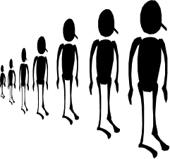
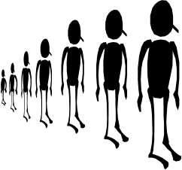
Conformity & Obedience
Behavior is contagious, modeled by one followed by another. We follow the behavior of others to conform.
Other behaviors may be the expression of compliance (obedience) toward authority.
Conformity Compliance Obedience

Slide 9
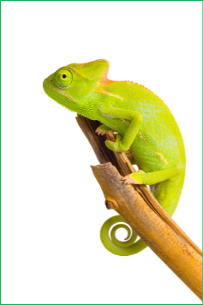
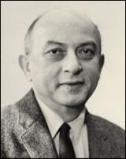
The Chameleon Effect
Conformity: adjusting one’s behavior or thinking to coincide with a group standard (Chartrand & Bargh, 1999).
Solomon Asch’s famous Line Experiment set out to test levels of conformity

Slide 10
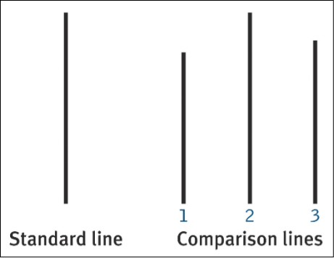
Asch’s Line Experiment
Suggestibility is a subtle type of conformity– adjusting our behavior or thinking toward some group standard.
Placed subjects in groups with pseudo-participants to see if subjects would succumb to pressure of the other group members to give the wrong answer.

Slide 11
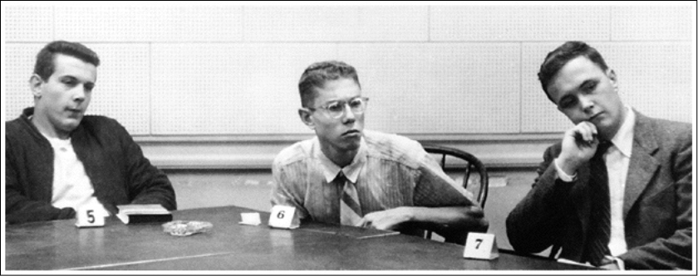
Asch’s Line Experiment
Found that about 1/3 of trial participants regularly conformed to the unanimous but erroneous group answer…with an average of 75% of all participants conforming at least once throughout experiment

Slide 12
Conditions that Influence Conformity
Size of the group – the more people, the more likely one is to conform (3+)
Status of the group – the lower a person’s status in a group, the more likely they are to conform
Observation of the group – if decision is made in private & anonymous, are less likely to conform
Unanimity of the group – conformity greater when all in the group agree

Slide 13
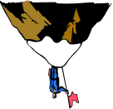
Reasons for Conformity
Normative Social Influence: want to avoid rejection or gain social approval
So…we respect the norms of the group.
Informative Social Influence: due to the fact that group may provide valuable information, want to accept the opinions of others
Especially when concerning tough decisions…we don’t want to stand alone in tough decisions.

Slide 14
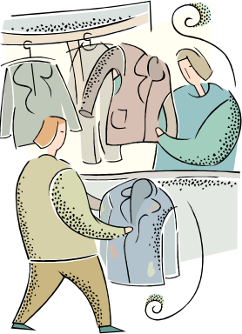
Compliance
Compliance: adjusting one’s behavior because of an explicit or implicit request
Explicit = direct request
Implicit = indirect request
Indirect requests could include asking for or implying something else…often used by salespeople and politicians

Slide 15
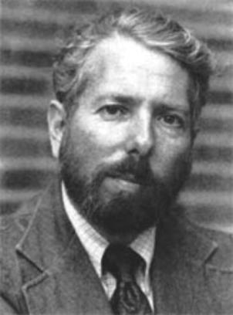
Obedience
Obedience: change in behavior in response to the command of someone in a position of authority
Stanley Milgram designed a study that investigated the effects of authority on obedience.
Stanley Milgram
(1933-1984)
Notes:
.1

Slide 16
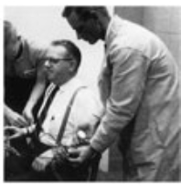
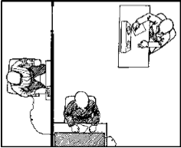
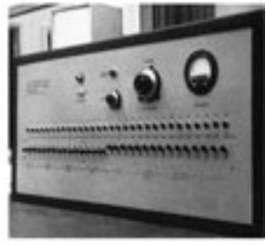
Milgram’s Study

Slide 17
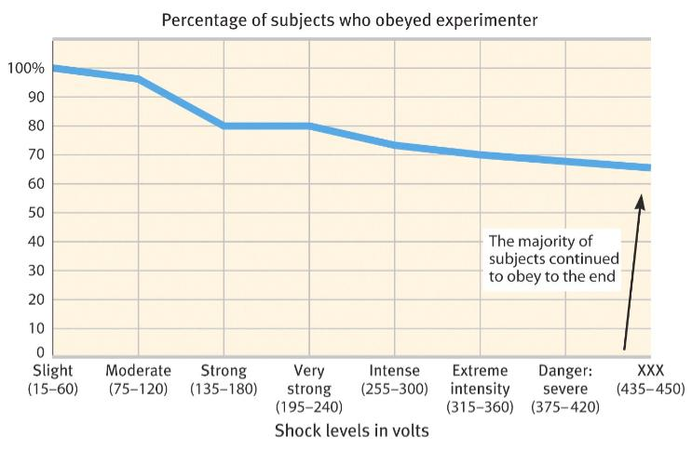
Milgram’s Study: Results
65% obeyed

Slide 18
Milgram’s Study: Results
Why did participants obey?
Most rationalized their obedience because they felt that the experimenter was ultimately responsible for what happened to other participant.
Influences on obedience…
Prestige – higher prestige of authority figure, harder to
disobey
Presence of others who disobey
Personality characteristics – it really does depend upon the person

Slide 19
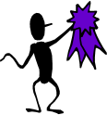
Social Dilemmas
Social Dilemmas – situations in which selfish behavior that benefits individuals in the short run may spell disaster for an entire group in the long run
Bonus points…
What do you think the outcome is?
Why did you pick the point value you did?

Slide 20
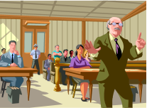
“Prisoner’s Dilemma”
2 people separated immediately after arrested for a serious crime – DA believes they are guilty but lacks evidence – each can either confess or not
DA tells them…
if both refuse to confess, each will be convicted of a minor offense and jailed for one year
if both confess, DA will recommend a 5-year sentence
if one remains silent and one confesses, DA will allow confessing prisoner to go free, whereas the other will serve the maximum 10-year sentence

Slide 21
Answer to Prisoner’s Dilemma
Best outcome??
Best mutual outcome attained through cooperation…
Meaning short sentences for both, so both would have to remain silent
Is this likely to happen? Why or why not?

Slide 22
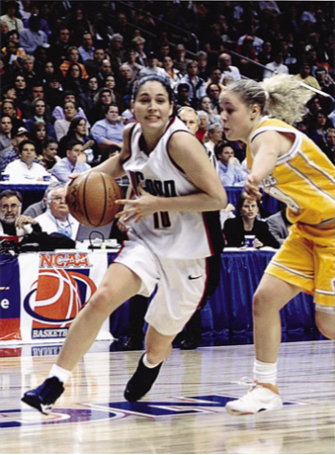
Behavior in the Presence of Others
Social facilitation: Refers to improved performance on a task in the presence of others.
Usually occurs with either simple or well-learned tasks, but not difficult or not-yet-mastered tasks.
Why?

Slide 23
Social Loafing
Tendency for people in a group to exert less effort than when working individually
Why?
Feel less accountable when in a group…may view contribution as dispensable or not important

Slide 24
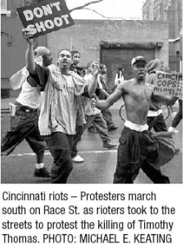
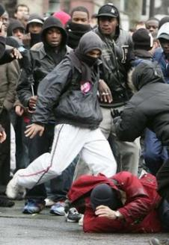
Deindividuation (mob mentality)
Loss of self-awareness and self-restraint in group situations that foster arousal and anonymity.
Mob behavior…no one can point you out, so again you feel less accountable for your individual actions

Slide 25
Deindividuation Activity
Do NOT write your name on the slip of paper
If you were invisible for one day, what would you do? Don't discuss, just write and put it on my chair up front.

Slide 26
Effects of Group Interaction
Group Polarization: enhances group’s prevailing attitudes through discussion. If a group is like-minded, discussion strengthens its prevailing opinions and attitudes.
Can be beneficial or harmful…bottom line, you usually leave more fired up one way of the other than when you first arrived

Slide 27
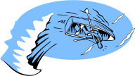
Groupthink
Way of thinking that occurs when the desire for harmony in decision-making overrides the possible alternatives
One doesn’t want to make waves… so goes along with the rest of the group’s decision or the decision of the most vocal member

Slide 28
https://www.youtube.com/watch?v=XVpV73wSyG8
The Human Behavior Experiments

